Slide 1
1.0 Introduction to Android
<number>

Slide 2

Contents
Android is an ecosystem
Android platform architecture
Android Versions
Challenges of Android app development
App fundamentals
<number>

Slide 3
Android Ecosystem
<number>

Slide 4
What is Mobile Ecosystem ?
Mobile Ecosystem is collection of multiple devices (mobile phones, Tablet etc), software (operating system, development tools, testing tools etc.), companies (device manufacturers, carrier, apps stores, development/testing companies, etc.)
<number>

Slide 5
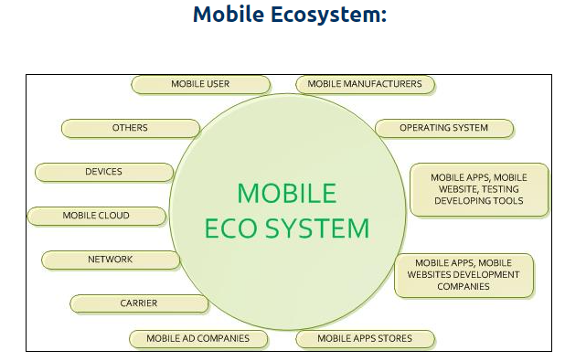
<number>

Slide 6
What is Android?
Mobile operating system based on Linux kernel
User Interface for touch screens
Used on over 80% of all smartphones
Powers devices such as watches, TVs, and cars
Over 3 Million Android apps in Google Play store
Highly customizable for devices / by vendors
Open source
<number>

Slide 7
Android user interaction
Touch gestures: swiping, tapping, pinching
Virtual keyboard for characters, numbers, and emoji
Support for Bluetooth, USB controllers and peripherals
<number>

Slide 8
Android and sensors
Sensors can discover user action and respond
Device contents rotate as needed
Walking adjusts position on map
Tilting steers a virtual car or controls a physical toy
Moving too fast disables game interactions
<number>

Slide 9
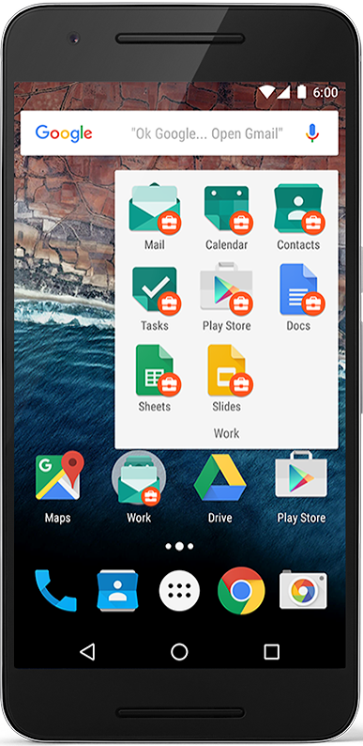
Android home screen
Launcher icons for apps
Self-updating widgets for live content
Can be multiple pages
Folders to organize apps
"OK Google"
<number>

Slide 10
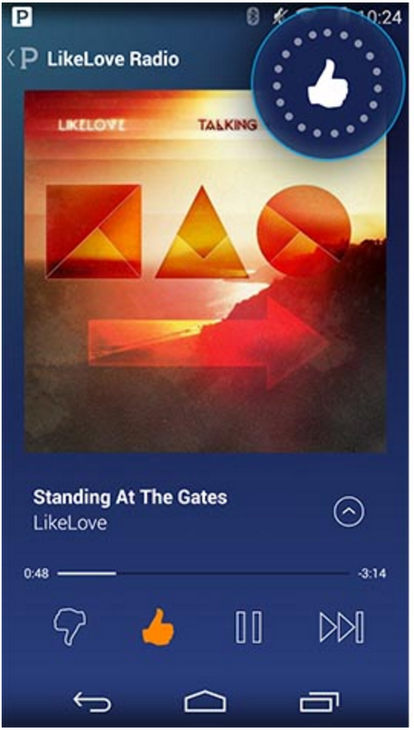
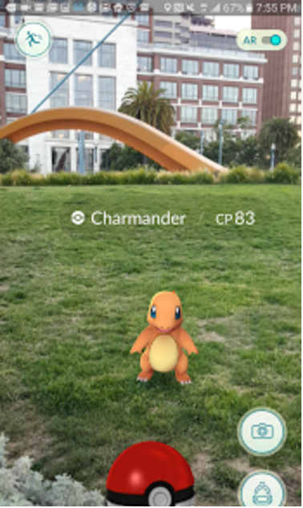
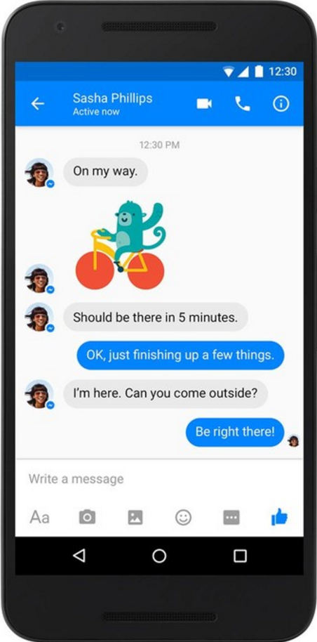
Android app examples
Pandora
Pokemon GO
Facebook Messenger
<number>

Slide 11
Android Software Developer Kit (SDK)
Development tools (debugger, monitors, editors)
Libraries (maps, wearables)
Virtual devices (emulators)
Documentation (developers.android.com)
Sample code
<number>

Slide 12
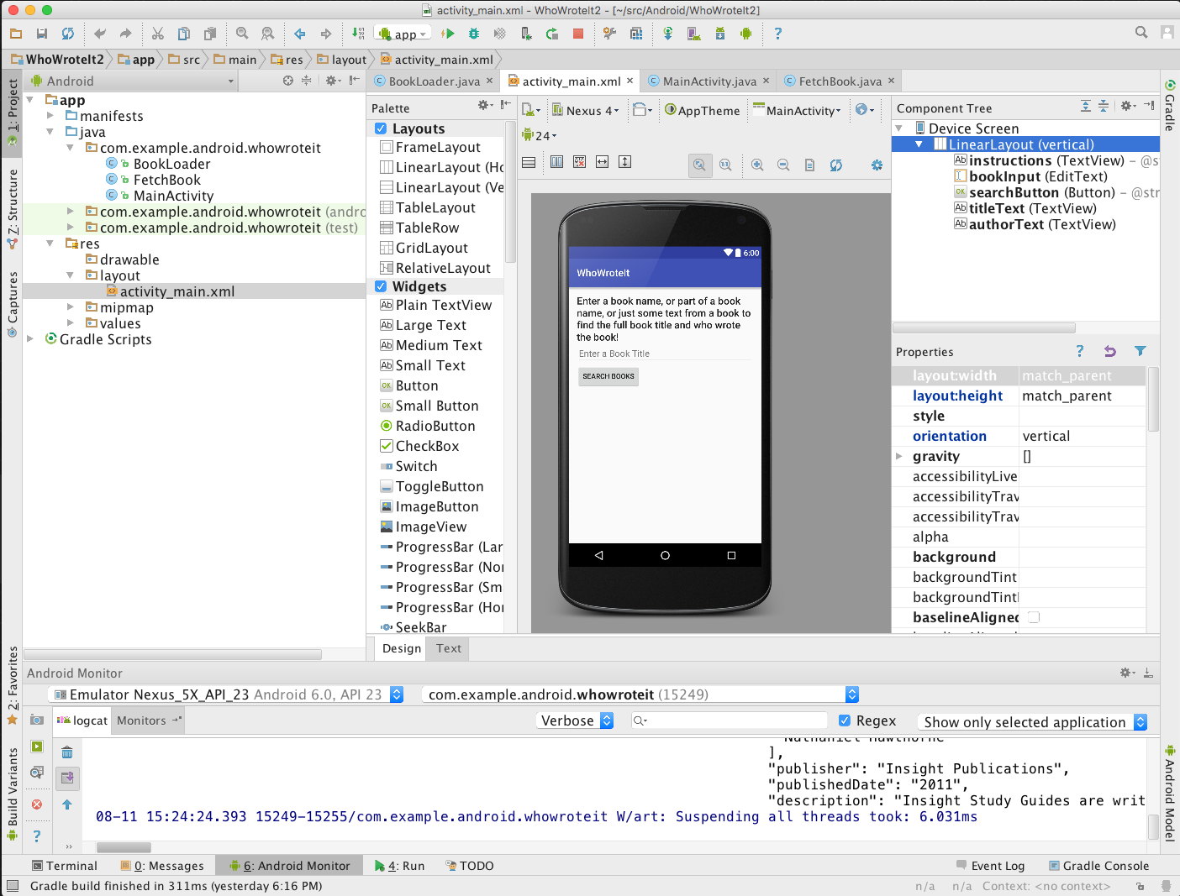
Android Studio
Official Android IDE
Develop, run, debug, test, and package apps
Monitors and performance tools
Virtual devices
Project views
Visual layout editor
<number>

Slide 13
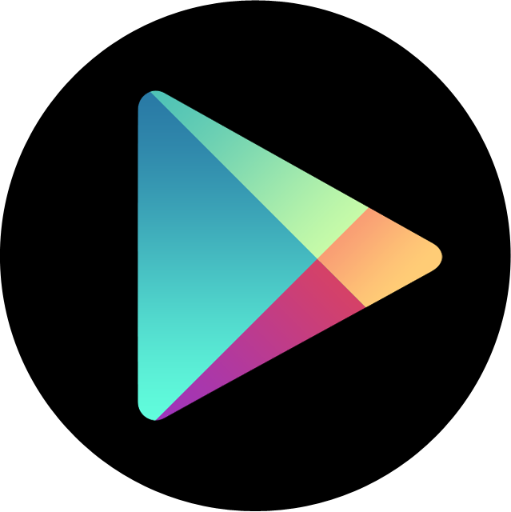
Google Play store
Publish apps through Google Play store:
Official app store for Android
Digital distribution service operated by Google
<number>

Slide 14
Android Platform Architecture
This work is licensed under a Creative Commons Attribution-NonCommercial 4.0 International License
<number>

Slide 15
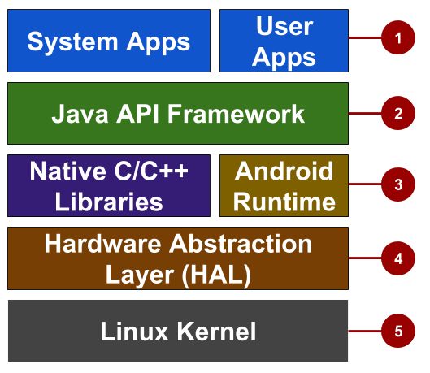
Android stack
System and user apps
Android OS API in Java framework
Expose native APIs; run apps
Expose device hardware capabilities
Linux Kernel
<number>

Slide 16
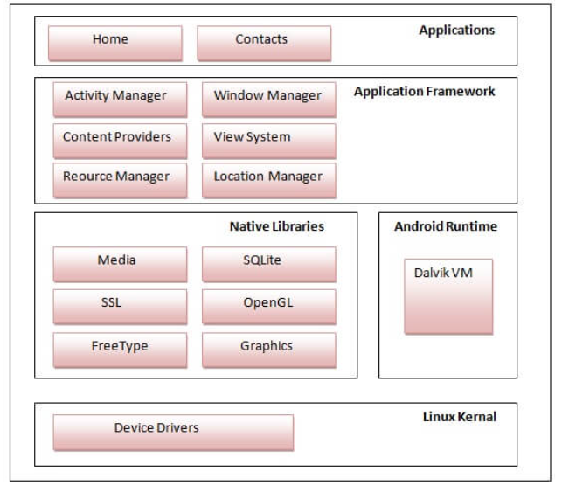
Android stack
<number>

Slide 17
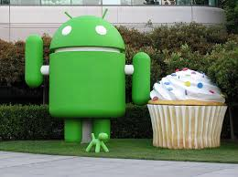
System and user apps
System apps have no special status
System apps provide key capabilities to app developers
Example:
Your app can use a system app to deliver a SMS message.
<number>

Slide 18
Java API Framework
The entire feature-set of the Android OS is available to you through APIs written in the Java language.
View class hierarchy to create UI screens
Notification manager
Activity manager for life cycles and navigation
Content providers to access data from other apps
<number>

Slide 19
Android runtime
Each app runs in its own process with its own instance of the Android Runtime.
In android runtime, there are core libraries and DVM (Dalvik Virtual Machine) which is responsible to run android application.
DVM is like JVM but it is optimized for mobile devices. It consumes less memory and provides fast performance.
<number>

Slide 20
Native libraries
Core C/C++ Libraries give access to core native Android system components and services.
Other Native libraries are WebKit, FreeType, SQLite, Media, C runtime library (libc) etc.
The WebKit library is responsible for browser support, SQLite is for database, FreeType for font support, Media for playing and recording audio and video formats.
<number>

Slide 21
Hardware Abstraction Layer (HAL)
Standard interfaces that expose device hardware capabilities as libraries Examples: Camera, bluetooth module
<number>

Slide 22
Linux Kernel
It is the heart of android architecture that exists at the root of android architecture.
Linux kernel is responsible for device drivers, power management, memory management, device management and resource access.Threading and low-level memory management,Security features and Drivers
<number>

Slide 23
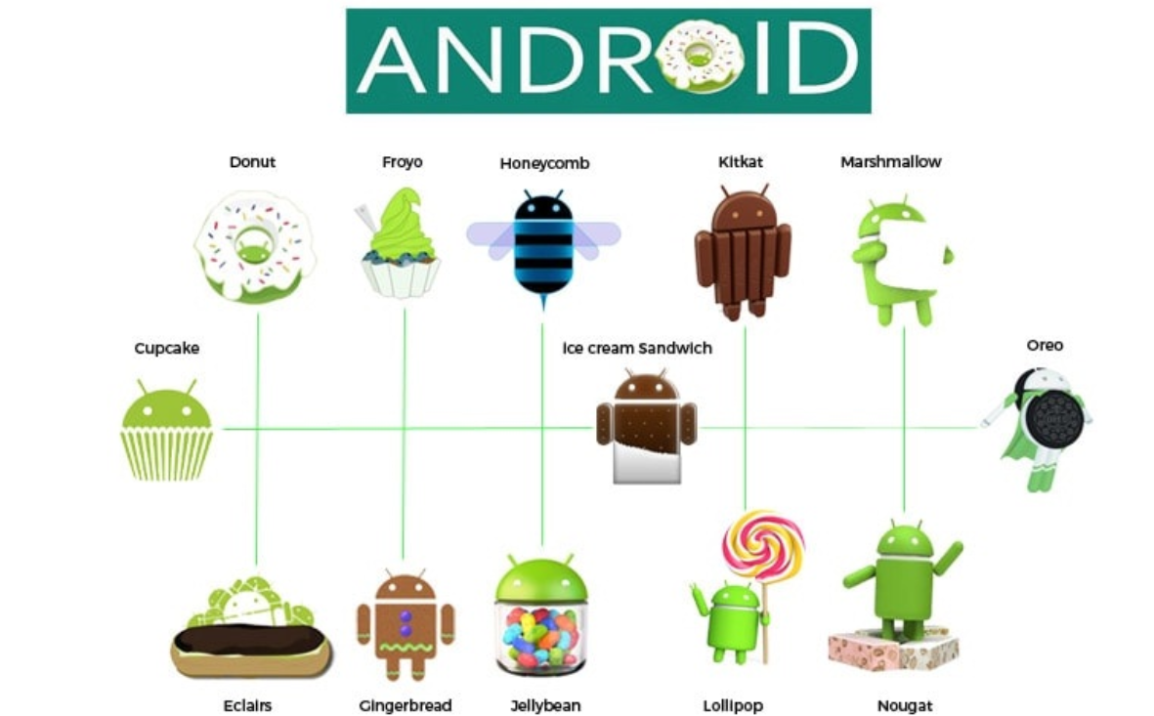


Android Versions
<number>

Slide 24

Android versions
Codename | Version | Released | API Level
Honeycomb | 3.0 - 3.2.6 | Feb 2011 | 11 - 13
Ice Cream Sandwich | 4.0 - 4.0.4 | Oct 2011 | 14 - 15
Jelly Bean | 4.1 - 4.3.1 | July 2012 | 16 - 18
KitKat | 4.4 - 4.4.4 | Oct 2013 | 19 - 20
Lollipop | 5.0 - 5.1.1 | Nov 2014 | 21 - 22
Marshmallow | 6.0 - 6.0.1 | Oct 2015 | 23
Nougat | 7.0 | Sept 2016 | 24
Android History and Platform Versions
for more and earlier versions before 2011
<number>
Notes:
There were earlier versions before Feb 2011.

Slide 25
App Development
This work is licensed under a Creative Commons Attribution-NonCommercial 4.0 International License
<number>

Slide 26
What is an Android app?
One or more interactive screens
Written using Java Programming Language and XML
Uses the Android Software Development Kit (SDK)
Uses Android libraries and Android Application Framework
Executed by Android Runtime Virtual machine (ART)
<number>

Slide 27
Challenges of Android development
Multiple screen sizes and resolutions
Performance: make your apps responsive and smooth
Security: keep source code and user data safe
Compatibility: run well on older platform versions
Marketing: understand the market and your users (Hint: It doesn't have to be expensive, but it can be.)
<number>

Slide 28
App building blocks
Resources: layouts, images, strings, colors as XML and media files
Components: activities, services, …, and helper classes as Java code
Manifest: information about app for the runtime
Build configuration: APK versions in Gradle config files
<number>

Slide 29
Component types
Activity is a single screen with a user interface
Service performs long-running tasks in background
Content provider manages shared set of data
Broadcast receiver responds to system-wide announcements
<number>

